Slide 1
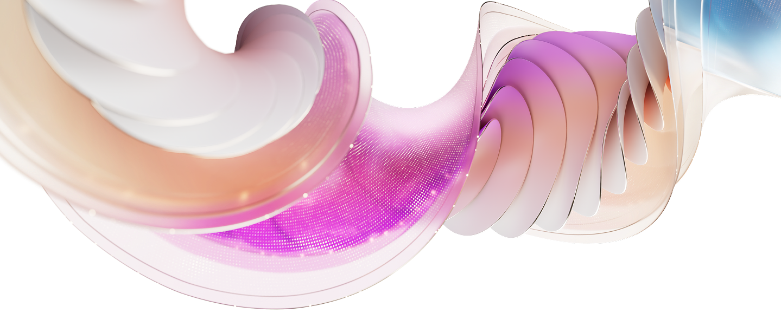
Upgrade investment snapshot from {starting_sku} to {target_sku}
Current SKU | {start_sku}​
# Seats | {seats}​
Current investment​ | {expiring_arr}
Upgrade solution​ | {target_sku}
# Proposed seats for upgrade​ | {add_proposed_seat}
Actual cost of the solution per user | {actual_price_per_user}
Savings from promo price | {promo_savings_per_user}
Cost per user after adjusting promo price | {per_user_after_promo_price}
Incremental cost per user​ | {incremental_cost_per_user}​
Total incremental annual investment for {seats} seats | {overall_incremental_cost}
[NOTE - PLEASE DELETE BEFORE SENDING TO THE CUSTOMER]
The calculation above is based on active promos, partner MAICPP status, Microsoft Commercial Incentives, and Microsoft list price, and assumes additional information on margins. This is for reference only and subject to change. Please review the calculation, and adjust before sending it to the customer. Microsoft would not be responsible for the content or accuracy of any information/claim made in this document, or for any decisions made based on such information.

